Slide 1
Design and Simulation of a Smart Water Tank Overflow Protection and Pump Control System

Slide 2
Presented by:
Sai Tanush – 2620040075
Sai Varshith – 2620040129
Sanjana - 2620040057
Mahima – 2620040049
Eshwar - 2620040101

Slide 3
Introduction And objectives
Design a digital logic circuit to control a water pump using a 2:1 multiplexer and basic logic gates.
Provide Automatic and Manual operating modes through a mode selection switch.
Prevent tank overflow by monitoring the high-level water sensor.
Protect the pump from dry running using a water-source availability sensor.
Generate an alarm when the tank is full or the water source is empty.
Verify the circuit operation through a truth table and Logisim simulation.

Slide 4
COMPONENTS used:
Component | Quantity | Purpose
Input pins | 4 | H, S, M, W
2:1 Multiplexer | 1 | Selects Auto or Manual command
NOT gate | 2 | Produces H′ and W′
AND gate (2-input) | 2 | Pump control and safety conditions
OR gate (2-input) | 1 | Alarm generation
Output pin | 2 | Pump (1 = ON, 0 = OFF) & Alarm
Logisim software | – | Design and simulation

Slide 5
Input and output definitions:
Signal | Meaning | 0 means | 1 means
H | High-level water sensor | Tank not full | Tank full
S | Manual switch | Pump OFF request | Pump ON request
M | Mode select | Automatic | Manual
W | Water source sensor | Source empty | Source has water
P | Pump output | Pump OFF | Pump ON
A | Alarm output | Alarm OFF | Alarm ON

Slide 6
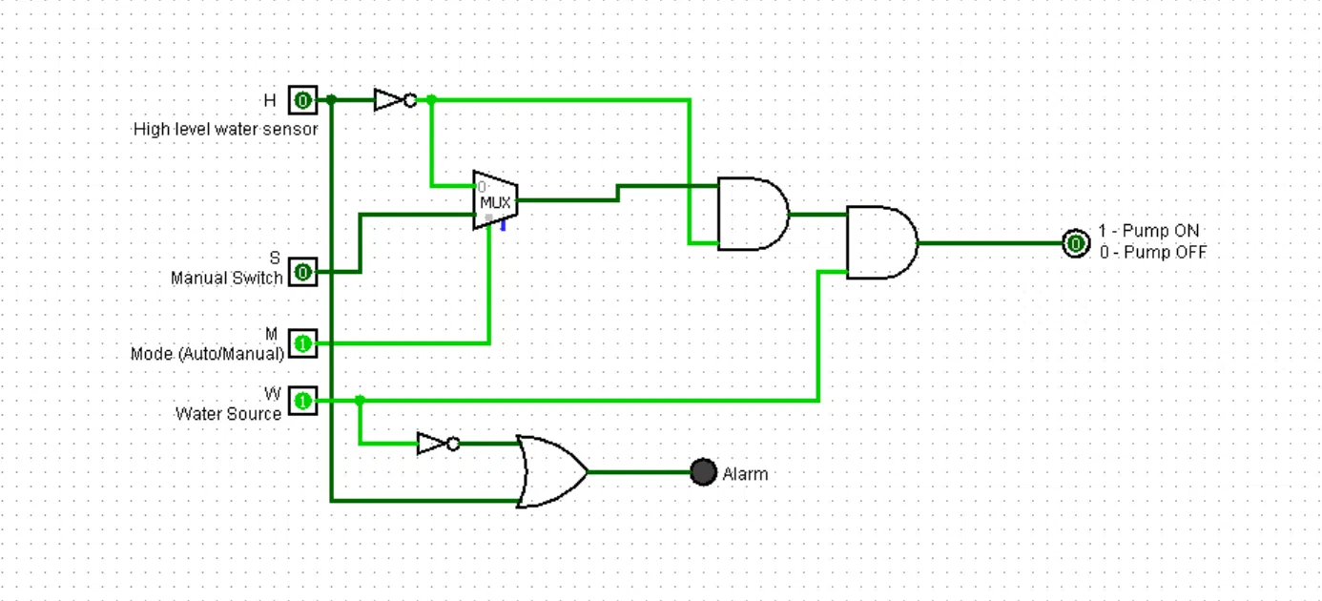
Logic diagram:

Slide 7
TRUTH table:
H | S | M | W | P (Pump) | A (Alarm)
0 | 0 | 0 | 0 | 0 | 1
0 | 0 | 0 | 1 | 1 | 0
0 | 0 | 1 | 0 | 0 | 1
0 | 0 | 1 | 1 | 0 | 0
0 | 1 | 0 | 0 | 0 | 1
0 | 1 | 0 | 1 | 1 | 0
0 | 1 | 1 | 0 | 0 | 1
0 | 1 | 1 | 1 | 1 | 0
1 | 0 | 0 | 0 | 0 | 1
1 | 0 | 0 | 1 | 0 | 1
1 | 0 | 1 | 0 | 0 | 1
1 | 0 | 1 | 1 | 0 | 1
1 | 1 | 0 | 0 | 0 | 1
1 | 1 | 0 | 1 | 0 | 1
1 | 1 | 1 | 0 | 0 | 1
1 | 1 | 1 | 1 | 0 | 1

Slide 8
Advantages and applications
Advantages
Prevents tank overflow and saves water and electricity.
Protects the motor from dry running.
Offers both automatic and manual control.
Safety conditions cannot be bypassed in manual mode.
Low cost and simple, with no microcontroller needed.
Easy to build in hardware with standard ICs (74157 MUX, 7408 AND, 7432 OR, 7404 NOT).
Applications
Domestic overhead and underground tanks
Apartments and housing societies
Hostels, schools and hospitals
Industrial storage tanks
Agriculture and irrigation systems

Slide 9
Conclusion
A smart water tank control system was designed and simulated using a 2:1 multiplexer and basic logic gates.
The multiplexer switches between Automatic and Manual modes using the mode input M.
The pump runs only when the tank is not full and the source has water.
The alarm sounds when the tank is full or the source is empty.
Logisim simulation matched the truth table, confirming correct operation.
Future scope: low-level sensor with hysteresis using a flip-flop, IoT monitoring, and GSM or mobile alerts.

Slide 10
Thank you

